Slide 1
Evolution of R&E Networks to Enable LHC Science
INFN / GARR meeting, May 15, 2012, Naples
William Johnston
Energy Sciences Network (ESnet)
wej@es.net

Slide 2
The LHC as Prototype for Large-Scale Science
The LHC is the first of a collection of science experiments that will generate data streams of order 100 Gb/s that must be analyzed by a world-wide consortium
SKA and ITER are coming
The model and infrastructure that are being built up to support LHC distributed data analysis have applicability to these projects
In this talk we look at the R&E network infrastructure evolution over the past 5 years to accommodate the LHC and how the resulting infrastructure might be applied to another large-data science project: The Square Kilometer Array radio telescope (see [SKA])

Slide 3
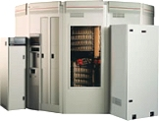
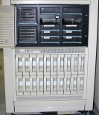
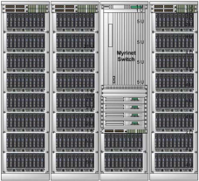
The LHC: Data management and analysis are highly distributed
CERN
ATLAS detector
Tier 0 Data Center
(1 copy of all data – archival only)
The ATLAS PanDA “Production and Distributed Analysis” system
ATLAS production jobs
Regional production jobs
User / Group analysis jobs
ATLAS Tier 1 Data Centers:
10 sites scattered across Europe, North America, and Asia, in aggregate hold 1 copy of all data and provide the working dataset for distribution to Tier 2 centers for analysis.
2) DDM locates data and moves it to sites. This is a complex system in its own right called DQ2.
Task Buffer
(job queue)
Policy
(job type priority)
Data Service
Job Broker
1) Schedules jobs initiates data movement
Job Dispatcher
Distributed Data Manager
PanDA Server
(task management)
4) Jobs are dispatched when there are resources available and when the required data is in place at the site
Site Capability Service
3) Prepares the local resources to receive Panda jobs
DDM
Agent
ATLAS analysis sites
(e.g. 30 Tier 2 Centers in Europe, North America and SE Asia)
DDM
Agent
DDM
Agent
Site status
DDM
Agent
Job resource manager
(dispatch a “pilot” job manager
- a Panda job receiver - when resources are available at a site).
Pilots run under the local site job manager (e.g. Condor, LSF, LCG, …) and accept jobs in a standard format from PanDA)
Pilot Job
(Panda job receiver running under the site-specific job manager)
Thanks to Michael Ernst, US ATLAS technical lead, for his assistance with this diagram, and to Torre Wenaus, whose view graphs provided the starting point. (Both are at Brookhaven National Lab.)
Grid Scheduler

Slide 4
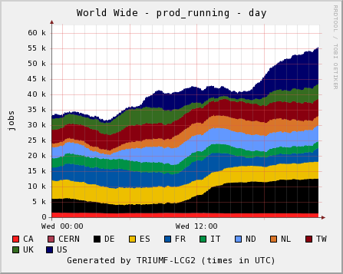
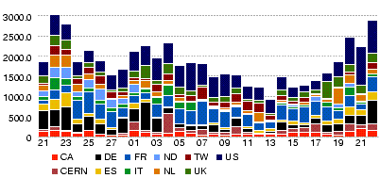
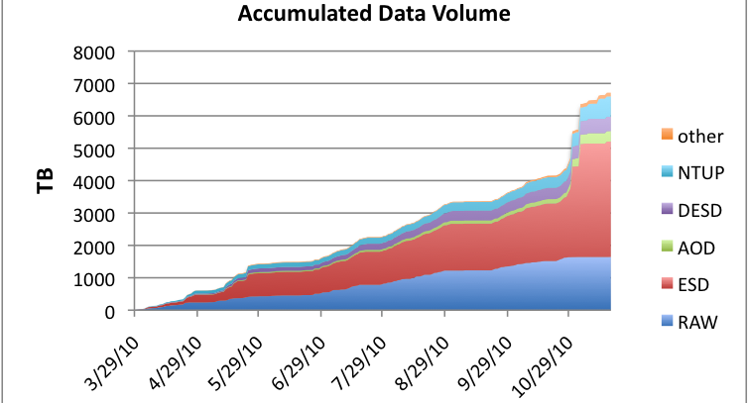
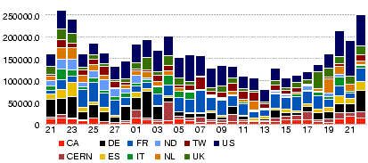
Scale of ATLAS analysis driven data movement
PanDA jobs during one day
Tier 1 to Tier 2 throughput (MBy/s) by day – up to 24 Gb/s – for all ATLAS Tier 1 sites
Accumulated Data Volume – cache disks
7 PB
Data Transferred (GBytes) (up to 250 Tby/day)
It is this scale of analysis jobs and resulting data movement, going on 24 hr/day, 9+ months/yr, that networks must support in order to enable the large-scale science of the LHC

Slide 5
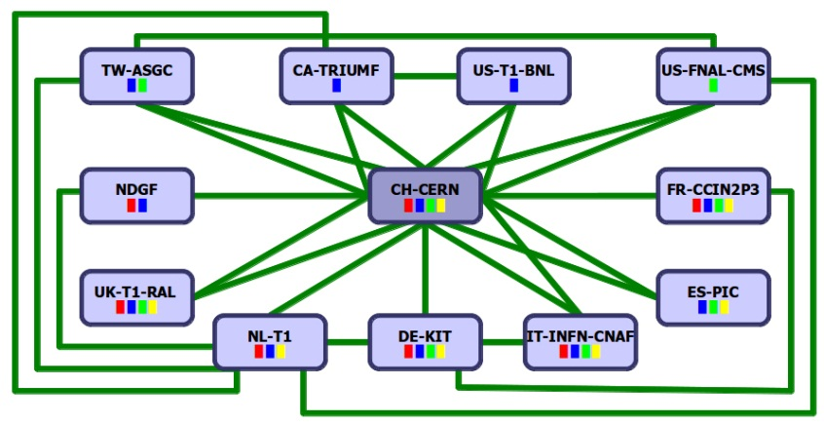

Enabling this scale of data-intensive system requires a sophisticated network infrastructure
A Network Centric View of the LHC
detector
O(1-10) meter
1 PB/s
CERN →T1 | miles | kms
France | 350 | 565
Italy | 570 | 920
UK | 625 | 1000
Netherlands | 625 | 1000
Germany | 700 | 1185
Spain | 850 | 1400
Nordic | 1300 | 2100
USA – New York | 3900 | 6300
USA - Chicago | 4400 | 7100
Canada – BC | 5200 | 8400
Taiwan | 6100 | 9850
Level 1 and 2 triggers
O(10-100) meters
Level 3 trigger
O(1) km
CERN Computer Center
500-10,000 km
50 Gb/s (25Gb/s ATLAS, 25Gb/s CMS)
Universities/
physics groups
Universities/
physics groups
LHC Tier 1 Data Centers
Universities/
physics groups
Universities/
physics groups
Universities/
physics groups
Universities/
physics groups
Universities/
physics groups
Universities/
physics groups
The LHC Open Network Environment
(LHCONE)
Universities/
physics groups
Universities/
physics groups
Universities/
physics groups
This is intended to indicate that the physics groups now get their data wherever it is most readily available
Universities/
physics groups
The LHC Optical Private Network (LHCOPN)
Universities/
physics groups
Universities/
physics groups
Universities/
physics groups
Universities/
physics groups
Universities/
physics groups
LHC Tier 2 Analysis Centers

Slide 6
In Addition to the Network Infrastructure, the Network Must be Provided as a Service
The distributed application system elements must be able to get guarantees from the network that there is adequate, error-free* bandwidth to accomplish the task at the requested time (see [DIS])
This service must be accessible within the Web Services / Grid Services paradigm of the distributed applications systems
* Why error-free? TCP is a “fragile workhorse:” It will not move very large volumes of data over international distances unless the network is error-free. (Very small packet loss rates result in large decreases in performance.)
For example, on a 10 Gb/s link, a loss rate of 1 packet in 22,000 in a LAN or metropolitan area network is barely noticeable
In a continental-scale network – 88 ms round trip time path (about that of across the US) – this loss-rate results in an 80x throughput decrease
Notes:
6

Slide 7
The Evolution of R&E Networks
How are the R&E networks responding to these requirement of guaranteed, error-free bandwidth for the LHC?
1) The LHC’s Optical Private Network - LHCOPN
2) Point-to-point virtual circuit service
The network as a service
3) Site infrastructure to support data-intensive science – the “Science DMZ”
Campus network infrastructure was not designed to handle the flows of large-scale science and must be updated
4) Monitoring infrastructure that can detect errors and facilitate their isolation and correction
5) The LHC’s Open Network Environment – LHCONE
Growing and strengthening transatlantic connectivity
Managing large-scale science traffic in a shared infrastructure

Slide 8
1) The LHC OPN – Optical Private Network
While the OPN was a technically straightforward exercise – establishing 10 Gb/s links between CERN and the Tier 1 data centers for distributing the detector output data – there were several aspects that were new to the R&E community
The issues related to the fact that most sites connected to the R&E WAN infrastructure through a site firewall and the OPN was designed to bypass the firewall
The security issues were addressed by using a private address space that hosted only LHC Tier 1 systems (see [LHCOPN Sec])

Slide 9
2) Point-to-Point Virtual Circuit Service
Designed to accomplish two things
1) Provide networking as a “service” to the LHC community
Schedulable with guaranteed bandwidth – as one can do with CPUs and disks
Traffic isolation that allows for using non-standard protocols that will not work well in a shared infrastructure
Some path characteristics may also be specified – e.g. diversity
2) Enable network operators to do “traffic engineering” – that is, to manage/optimize the use of available network resources
Network engineers can select the paths that the virtual circuits use
and therefore where in the network the traffic shows up
this ensures adequate capacity is available for the circuits and, at the same time, ensures that other uses of the network are not interfered with
ESnet’s OSCARS provided one of the first implementations of this service (see [OSCARS])
Essentially a routing control plane that is independent from the router/switch devices
MPLS, Ethernet VLANs, GMPLS, and OpenFlow

Slide 10
3) Site infrastructure to support data-intensive science
WAN-LAN impedance matching at sites: The Science DMZ
The site network – the LAN – typically provides connectivity for local resources – compute, data, instrument, collaboration system, etc.
The T1 and T2 site LAN architectures must be designed to match the high-bandwidth, large data volume, large round trip time (RTT) (international paths) wide area network (WAN) flows to the LAN in order to provide access to local resources (e.g. compute and storage systems). (See [DIS].)
otherwise the site will impose poor performance on the entire high speed data path, all the way back to the source

Slide 11
The Science DMZ
The devices and configurations typically deployed to build networks for business and small data-flow purposes usually don’t work for large-scale data flows
firewalls, proxy servers, low-cost switches, and so forth.
none of which will allow high volume, high bandwidth, long RTT data transfer
Large-scale data resources should be deployed in a separate portion of the network that has a different packet forwarding path and tailored security policy
dedicated systems built and tuned for wide-area data transfer
test and measurement systems for performance verification and rapid fault isolation, typically perfSONAR (see [perfSONAR])
a security policy tailored for science traffic and implemented using appropriately capable hardware
Concept resulted primarily from Eli Dart’s work with the DOE supercomputer centers

Slide 12
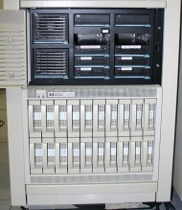


The Science DMZ
secured campus/site
access to Internet
Site DMZ
Web
WAN
DNS
border router
Mail
(See http://fasterdata.es.net/science-dmz/ and [SDMZ] for a much more complete discussion of the various approaches.)
campus/site access to
Science DMZ
resources
clean,
high-bandwidth
WAN data path
campus / site
LAN
Science DMZ
Science DMZ
router/switch
high performance Data Transfer Node
per-service
security policy
control points
computing cluster
campus / site

Slide 13
4) Monitoring infrastructure
The only way to keep multi-domain, international scale networks error-free is to test and monitor continuously end-to-end.
perfSONAR provides a standardize way to export, catalogue (the Measurement Archive), and access performance data from many different network domains (service providers, campuses, etc.)
Has a standard set of test tools
Can be used to schedule routine testing of critical paths
Test results can be published to the MA
perfSONAR is a community effort to define network management data exchange protocols, and standardized measurement data gathering and archiving
deployed extensively throughout LHC related networks and international networks and at the end sites (See [fasterdata], [perfSONAR], [badPS], and [NetSrv].)
PerfSONAR is designed for federated operation
Each domain maintains control over what data is published
Published data is federated in Measurement Archives that tools can use to produce end-to-end, multi-domain views of network performance

Slide 14
PerfSONAR
PerfSONAR measurement points are deployed in R&E networks and dozens of R&E institutions in the US and Europe
These services have already been extremely useful to help debug a number of hard network debugging problems
perfSONAR is designed to federate information from multiple domains
provides the only tool that we have to monitor circuits end-to-end across the networks from the US to Europe
The value of perfSONAR increases as it is deployed at more sites
The protocol follows work of the Open Grid Forum (OGF) Network Measurement Working Group (NM-WG) and is based on SOAP XML messages
See perfsonar.net

Slide 15
5) LHCONE: Evolving and strengthening transatlantic connectivity
Both ATLAS and CMS Tier 2s (mostly physics analysis groups at universities) have largely abandoned the old hierarchical data distribution model
Tier 1 -> associated Tier 2 -> Tier 3
in favor of a chaotic model: get whatever data you need from wherever it is available
Tier 1 -> any Tier 2 <-> any Tier 2 <-> any Tier 3
In 2010 this resulted in enormous site-to-site data flows on the general IP infrastructure at a scale that has previously only been seen from DDOS attacks

Slide 16
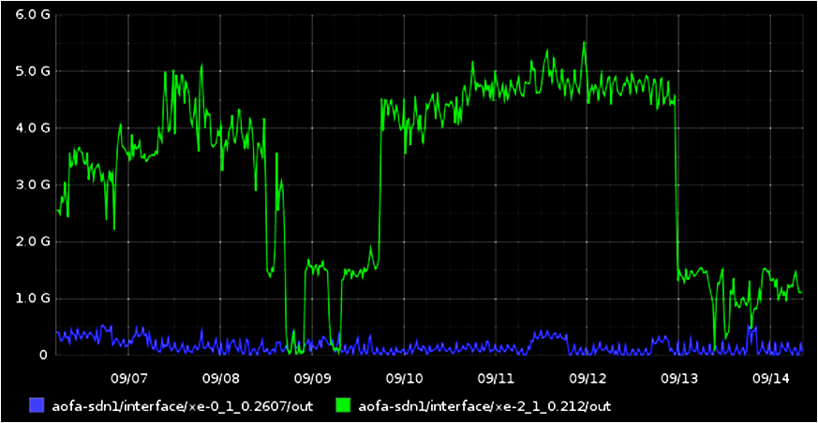
The Need for Traffic Engineering – Example
GÉANT observed a big spike on their transatlantic peering connection with ESnet (9/2010) coming from Fermilab – the U.S. CMS Tier 1 data center
Traffic, Gbps, at ESnet-GEANT Peering in New York
Scale is 0 – 6.0 Gbps
This caused considerable concern because at the time this was the only link available for general R&E

Slide 17
The Need for Traffic Engineering – Example
After some digging, the nature of the traffic was determined to be parallel data movers, but with an uncommonly high degree of parallelism: 33 hosts at a UK site and about 170 at FNAL
The high degree of parallelism means that the largest host-host data flow rate is only about 2 Mbps, but in aggregate this data mover farm is doing about 5 Gb/s for several weeks and moved 65 TBytes of data
this also makes it hard to identify the sites involved by looking at all of the data flows at the peering point – nothing stands out as an obvious culprit unless you correlate a lot of flows that are small compared to most data flows

Slide 18
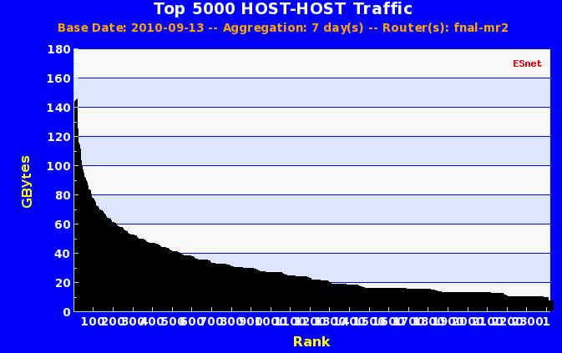
The Need for Traffic Engineering – Example
This graph shows all flows inbound to Fermilab
All of the problem transatlantic traffic was in flows at the right-most end of the graph
Most of the rest of the Fermi traffic involved US Tier 2, Tier 1, and LHCOPN from CERN – all of which is on engineered links

Slide 19
The Need for Traffic Engineering – Example
This clever physics group was consuming 50% of the available bandwidth on the primary U.S. – Europe general R&E IP network link – for weeks at a time!
This is obviously an unsustainable situation
this is the sort of thing that will force the R&E network operators to mark such traffic on the general IP network as scavenger (low priority) to ensure other uses of the network

Slide 20
The Problem (2010)
T1
T2
NREN1
T2
T2
T2
Ex
general R&E traffic path
T1
Paris
MAN LAN/New York
Ex
ESnet
T2
GÉANT
T1
only circuit based traffic
Ex
MAX/DC
Ex
T2
T3
Ex
NREN2
AMS
Internet2
T1
private R&E usage
T3
T2
The default routing for most IP traffic overloads certain paths. In particular, the GEANT ↔ New York path which carried most of the general R&E traffic across the Atlantic in 2010.
StarLight
Ex
T2
T2
T2

Slide 21
Response
LHCONE is intended to provide a private, managed infrastructure designed for LHC Tier 2 traffic (and likely other large-data science projects in the future)
The LHC traffic will use circuits designated by the network engineers
To ensure continued good performance for the LHC and to ensure that other traffic is not impacted
The last point is critical because apart from the LHCOPN, the R&E networks are funded for the benefit of the entire R&E community, not just the LHC
This can be done because there is capacity in the R&E community that can be made available for use by the LHC collaboration that cannot be made available for general R&E traffic
See LHCONE.net

Slide 22
How LHCONE Evolved
Three things happened that addressed the problem described above:
The R&E networking community came together and decided that the problem needed to be addressed
The NSF program that funded U.S. to Europe transatlantic circuits was revised so that the focus was more on supporting general R&E research traffic rather than specific computer science / network research projects.
The resulting ACE (“America Connects to Europe”) project has funded several new T/A circuits and plans to add capacity each of the next several years, as needed
DANTE/GÉANT provided corresponding circuits
Many other circuits have also been put into the pool that is available (usually shared) to LHCONE

Slide 23
How LHCONE Evolved
The following transoceanic circuits have been made available to support LHCONE:
Taipei, ASGC 2.5G to Amsterdam 10G to Chicago (StarLight) Chicago, StarLight 2 x 1G to Mexico City Copenhagen, NORDUnet 20G to Amsterdam 10G to New York (MAN LAN) 10G to Washington, DC (WIX) Amsterdam, NetherLight and GÉANT 10G to Chicago (GÉANT) 10G to Chicago (US NSF/ACE) 30G to New York (GÉANT and US NSF/ACE) 10G to New York (USLHCnet) Frankfurt, GÉANT 20G to Washington, DC (WIX), (GÉANT and US NSF/ACE) | Geneva, CERN 10G to GÉANT 10G to Amsterdam 10G to New York (via USLHCnet) 1G (?) to Korea 1G (?) to India

Slide 24
The LHCONE Services
An initial attempt to build a global, broadcast Ethernet VLAN that everyone could connect to with an assigned address was declared unworkable given the available engineering resources
The current effort is focused on a multipoint service – essentially a private Internet for the LHC Tier 2 sites that uses circuits designated for the LHC traffic
Provided as an interconnected set of localized private networks called Virtual Routing and Forwarding (VRF) instances
Each major R&E network provides the VRF service for its LHC sites
The VRFs are connected together and announce all of their sites to each other
The sites connect to their VRF provider using a virtual circuit (e.g. a VLAN) connection to establish a layer 3 (IP) routed peering relationship with the VRF that is separate from their general WAN peering
The next LHCONE service being worked on is a guaranteed bandwidth, end-to-end virtual circuit service

Slide 25
The LHCONE Multipoint Service
Sites announce addresses of LHC systems or subnets devoted to LHC systems
Site 4
Site 1
announces routes
VRF provider 2
VRF provider 1
Site 5
Site 2
accepts routes
Site 6
Site 3
announces routes
announces routes
routes between all of the announced addresses
Announces site provided addresses (“routes”) to other VRF providers
accepts route announcements from other VRF providers and makes them available to the sites
accepts routes
accepts routes
Site 7
VRF provider 3
Links suitable for LHC traffic
Site 8
The result is that sites 1-9 can all communicate with each other and the VRF providers can put this traffic onto links between themselves that are designed for LHC traffic.
Site 9

Slide 26
The LHCONE Multipoint Service
Sites have to do some configuration work
A virtual circuit (e.g. VLAN or MPLS) or physical circuit has to be set up from the site to the VRF provider
Site router has to be configured to announce the LHC systems to the VRF
LHCONE is separate from LHCOPN
Recent implementation discussions have indicated that some policy is necessary for the LHCONE multipoint service to work as intended
Sites may only announce LHC-related systems to LHCONE
Sites must accept all routes provided by their LHCONE VRF (as the way to reach other LHC sites)
Otherwise highly asymmetric routes are likely to result, with, e.g., inbound traffic from another LHC site coming over LHCONE and outbound traffic to that site using the general R&E infrastructure
The current state of the multipoint service implementation is fairly well advanced

Slide 27




















LHCONE: A global infrastructure for the LHC Tier1 data center – Tier 2 analysis center connectivity
SimFraU
NDGF-T1a
UVic
UAlb
NDGF-T1a
NDGF-T1c
UTor
NIKHEF-T1
NORDUnet
Nordic
TRIUMF-T1
CANARIE
Canada
McGilU
SARA
Netherlands
Korea
CERN-T1
KISTI
Korea
UMich
CERN
Geneva
UltraLight
Amsterdam
TIFR
India
Geneva
Chicago
KNU
DESY
KERONET2
Korea
GSI
DE-KIT-T1
SLAC
DFN
Germany
ESnet
USA
New York
India
Seattle
FNAL-T1
BNL-T1
ASGC-T1
GÉANT
Europe
ASGC
Taiwan
UCSD
Caltech
NE
Washington
UWisc
UFlorida
SoW
CC-IN2P3-T1
NCU
NTU
PurU
UNeb
MidW
Sub-IN2P3
TWAREN
Taiwan
MIT
GLakes
GRIF-IN2P3
RENATER
France
CEA
Internet2
USA
Harvard
PIC-T1
INFN-Nap
CNAF-T1
RedIRIS
Spain
GARR
Italy
UNAM
LHCONE VRF domain
End sites – LHC Tier 2 or Tier 3 unless indicated as Tier 1
Regional R&E communication nexus
Data communication links, 10, 20, and 30 Gb/s
See http://lhcone.net for details.
CUDI
Mexico
NTU
Chicago
April 2012

Slide 28
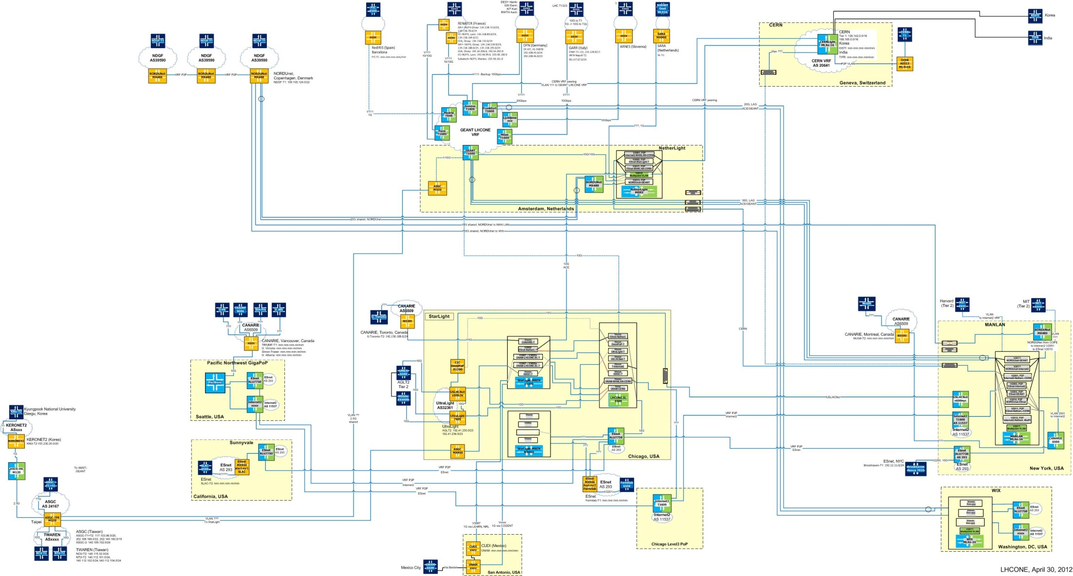
LHCONE as of April 30, 2012
The LHCONE drawings are at http://es.net/RandD/partnerships/lhcone
For general information see lhcone.net

Slide 29
Next Generation Science – the SKA
William E. Johnston and Roshene McCool (Domain Specialist in Signal Transport and Networks, SKA Program Development Office, Jodrell Bank Centre for Astrophysics, mccool@skatelescope.org)
The Square Kilometer Array – SKA – is a radio telescope consisting of several thousand antennae that operate as a single instrument to provide an unprecedented astronomy capability, and in the process generates an unprecedented amount of data that have to be transported over networks.
The telescope consists of 3500 antennae with collection area of approximately 1 square kilometer spread over almost a million sq. km.
Due to the need for a clear, dry atmosphere and low ambient RFI (minimal human presence), the SKA will be located in a remote high-desert area in either Australia or South Africa.
As a radio telescope, the SKA will be some 50 times more sensitive and a million times faster in sky scans than the largest currently operational radio telescopes.

Slide 30
SKA science motivation
The five Key Science Projects are:
Probing the Dark Ages: investigating the formation of the first structures, as the Universe made the transition from largely neutral to its largely ionized state today.
Galaxy Evolution, Cosmology and Dark Energy: probing the structure of the Universe and its fundamental constituent, galaxies, by carrying out all-sky surveys of continuum emission and of HI to a redshift z ~ 2. HI surveys can probe both cosmology (including dark energy) and the properties of galaxy assembly and evolution.
The Origin and Evolution of Cosmic Magnetism: magnetic fields are an essential part of many astrophysical phenomena, but fundamental questions remain about their evolution, structure, and origin. The goal of this project is to trace magnetic field evolution and structure across cosmic time.
Strong Field Tests of Gravity Using Pulsars and Black Holes: identifying a set of pulsars on which to conduct high precision timing measurements. The gravitational physics that can be extracted from these data can be used to probe the nature of space and time.
The Cradle of Life: probing the full range of astrobiology, from the formation of prebiotic molecules in the interstellar medium to the emergence of technological civilizations on habitable planets.

Slide 31
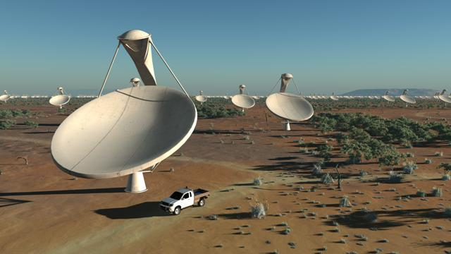
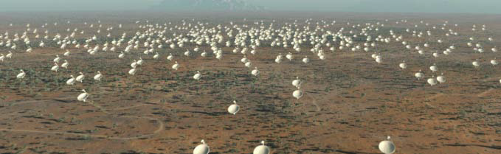
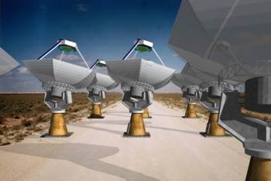
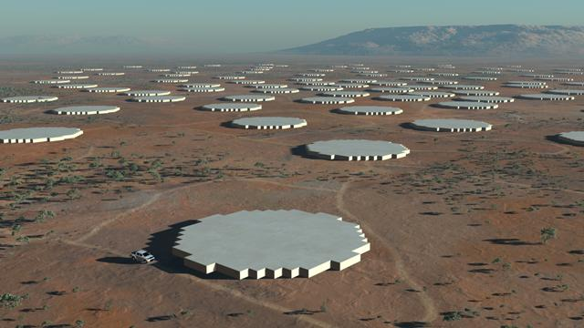
SKA types of sensors/receptors [2]
Dishes + wide-band single pixel feeds. This implementation of the mid-band SKA covers the 500 MHz to 10 GHz frequency range.
Dishes + Phased Array Feeds. Many of the main SKA science projects involve surveys of the sky made at frequencies below ~3 GHz. To implement these surveys within a reasonable time frame requires a high survey speed. By the use of a Phased Array Feed, a single telescope is able to view a considerably greater area of sky than would be the case with a single feed system.
Aperture arrays. An aperture array is a large number of small, fixed antenna elements coupled to appropriate receiver systems which can be arranged in a regular or random pattern on the ground. A beam is formed and steered by combining all the received signals after appropriate time delays have been introduced to align the phases of the signals coming form a particular direction. By simultaneously using different sets of delays, this can be repeated many times to create many independent beams, yielding very large total Field of Views.

Slide 32
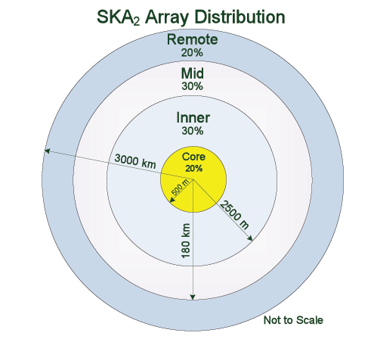
Distribution of SKA collecting area
Diagram showing the generic distribution of SKA collecting area in the core, inner, mid and remote zones for the dish array. [1]
700 antennae in a 1km diameter core area,
1050 antennae outside the core in a 5km diameter inner area,
1050 antennae outside the inner area in a 360km diameter mid area, and
700 antennae outside the mid area in a remote area that extends out as far as 3000km
The core + inner + mid areas are collectively referred to as the central area

Slide 33
SKA sensor / receptor data characteristics
sensor | Gb/s per sensor | Number of sensors | Gb/s total
PAFs | 930
SPFs | 216 | 130 | 28,080
SPF with PAFs | 1,146 | 2270 | 2,601,420
AA-low | 33,440 | 250 | 8,360,000
AA-mid | 16,800 | 250 | 4,200,000
total |  | 2900 | 15,161,420

Slide 34
Using the LHC to provide an analogy for a SKA data flow model
Receptors/sensors
~15,000 Tb/s aggregate
~200km, avg.
correlator / data processor
~1000 km
400 Tb/s aggregate
supercomputer
~25,000 km
(Perth to London via USA)
or
~13,000 km
(South Africa to London)
0.1 Tb/s (100 Gb/s) aggregate
from SKA RFI
European distribution point
1 fiber data path per tier 1 data center
.03 Tb/s each
Hypothetical
(based on the LHC experience)
National
tier 1
National
tier 1
National
tier 1
Universities/
astronomy groups
Universities/
astronomy groups
Universities/
astronomy groups
Universities/
astronomy groups
Universities/
astronomy groups
Universities/
astronomy groups
Universities/
astronomy groups
Universities/
astronomy groups
Universities/
astronomy groups

Slide 35
Using the LHC to provide an analogy for a SKA data flow model
Receptors/sensors
This regime is unlike anything at the LHC: It involves a million fibers in a 400km dia. area converging on a data processor.
~15,000 Tb/s aggregate
~200km, avg.
correlator / data processor
This regime is also unlike anything at the LHC: It involves long distance transport of ~1000, 400 Gb/s optical channels
~1000 km
400 Tb/s aggregate
supercomputer
~25,000 km
(Perth to London via USA)
or
~13,000 km
(South Africa to London)
0.1 Tb/s (100 Gb/s) aggregate
LHCOPN-like
from SKA RFI
European distribution point
1 fiber data path per tier 1 data center
.03 Tb/s each
Hypothetical
(based on the LHC experience)
LHCONE-like
National
tier 1
National
tier 1
National
tier 1
Universities/
astronomy groups
Universities/
astronomy groups
Universities/
astronomy groups
Universities/
astronomy groups
Universities/
astronomy groups
Universities/
astronomy groups
Universities/
astronomy groups
Universities/
astronomy groups
Universities/
astronomy groups

Slide 36
Using the LHC to provide an analogy for a SKA data flow model
For more information on the data movement issues and model for the SKA, see “The Square Kilometer Array – A next generation scientific instrument and its implications for networks,”
William E. Johnston, Senior Scientist, ESnet, Lawrence Berkeley National Laboratory and
Roshene McCool, Domain Specialist in Signal Transport and Networks, SKA Program Development Office, Jodrell Bank Centre for Astrophysics.
TERENA Networking Conference (TNC) 2012, available at https://tnc2012.terena.org/core/presentation/44

Slide 37
References
[SKA] “SKA System Overview (and some challenges).” P. Dewdney, Sept 16, 2010. http://www.etn-uk.com/Portals/0/Content/SKA/An%20Industry%20Perspective/13_Dewdney.pdf
[DIS] “Infrastructure for Data Intensive Science – a bottom-up approach, “Eli Dart and William Johnston, Energy Sciences Network (ESnet), Lawrence Berkeley National Laboratory. To be published in Future of Data Intensive Science, Kerstin Kleese van Dam and Terence Critchlow, eds. Also see http://fasterdata.es.net/fasterdata/science-dmz/
[LHCOPN Sec] at https://twiki.cern.ch/twiki/bin/view/LHCOPN/WebHome see “LHCOPN security policy document”
[OSCARS] “Intra and Interdomain Circuit Provisioning Using the OSCARS Reservation System.” Chin Guok; Robertson, D.; Thompson, M.; Lee, J.; Tierney, B.; Johnston, W., Energy Sci. Network, Lawrence Berkeley National Laboratory. In BROADNETS 2006: 3rd International Conference on Broadband Communications, Networks and Systems, 2006 – IEEE. 1-5 Oct. 2006. Available at http://es.net/news-and-publications/publications-and-presentations/ “Network Services for High Performance Distributed Computing and Data Management,” W. E. Johnston, C. Guok, J. Metzger, and B. Tierney, ESnet and Lawrence Berkeley National Laboratory, Berkeley California, U.S.A. The Second International Conference on Parallel, Distributed, Grid and Cloud Computing for Engineering,12-15 April 2011, Ajaccio - Corsica – France. Available at http://es.net/news-and-publications/publications-and-presentations/
“Motivation, Design, Deployment and Evolution of a Guaranteed Bandwidth Network Service,” William E. Johnston, Chin Guok, and Evangelos Chaniotakis. ESnet and Lawrence Berkeley National Laboratory, Berkeley California, U.S.A. In TERENA Networking Conference, 2011. Available at http://es.net/news-and-publications/publications-and-presentations/
Notes:
37

Slide 38
References
[perfSONAR] See “perfSONAR: Instantiating a Global Network Measurement Framework.” B. Tierney, J. Metzger, J. Boote, A. Brown, M. Zekauskas, J. Zurawski, M. Swany, M. Grigoriev. In proceedings of 4th Workshop on Real Overlays and Distributed Systems (ROADS'09) Co-located with the 22nd ACM Symposium on Operating Systems Principles (SOSP), October, 2009. Available at http://es.net/news-and-publications/publications-and-presentations/
[SDMZ] see ‘Achieving a Science "DMZ“’ at http://fasterdata.es.net/assets/fasterdata/ScienceDMZ-Tutorial-Jan2012.pdf and the podcast of the talk at http://events.internet2.edu/2012/jt-loni/agenda.cfm?go=session&id=10002160&event=1223
[fasterdata] See http://fasterdata.es.net/fasterdata/perfSONAR/
[badPS] How not to deploy perfSONAR: See “Dale Carder University of Wisconsin [pdf] “ at http://events.internet2.edu/2012/jt-loni/agenda.cfm?go=session&id=10002191&event=1223
[NetServ] “Network Services for High Performance Distributed Computing and Data Management.” W. E. Johnston, C. Guok, J. Metzger, and B. Tierney, ESnet and Lawrence Berkeley National Laboratory. In The Second International Conference on Parallel, Distributed, Grid and Cloud Computing for Engineering, 12‐15 April 2011. Available at http://es.net/news-and-publications/publications-and-presentations/
[LHCONE] http://lhcone.net
Notes:
38

